Slide 1
OrderEase-Smart Voice Assistant for Automating Restaurant Orders
Group Members:
Abdul Rehman 2022-CS-57
Mudasir Ahmed 2022-CS-77 (Scrum Master)
Abdul Rehman Afzal 2022-CS-79
Instructor: Dr. Khaldoon Khurshid

Slide 2

Objective: Automate restaurant order-taking through voice interaction to streamline management and reduce manual input.
Key Features:
AI-based speech-to-text order system
Automated form filling
Order tracking for users and admins

Slide 3
Agile Development Methodology
Development Method: Agile model following Scrum
Scrum Advantages:
Flexibility to adapt based on stakeholder feedback
Incremental delivery ensuring frequent updates
Collaboration among team members to enhance product quality

Slide 4
Scrum Roles
Scrum Master: Mudasir Ahmed
Disciplined Agile Team Lead: Abdul Rehman Irfan
Development Team: Frontend: Equal Experience, Backend: Abdul Rehman

Slide 5
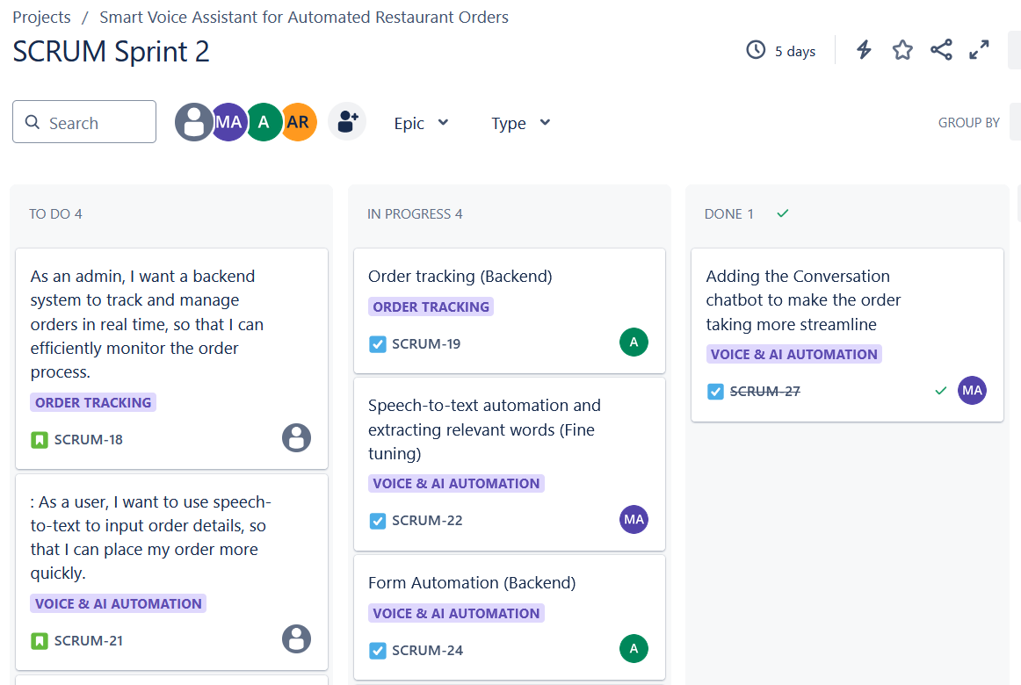
Scrum Artifacts & Tools
Product Backlog: Key user stories such as browsing the menu, adding to cart, and tracking orders.
Sprint Backlog: Features worked on (e.g., Order Tracking, Voice AI).
Tool Used: Jira for managing the Scrum board and task tracking.

Slide 6
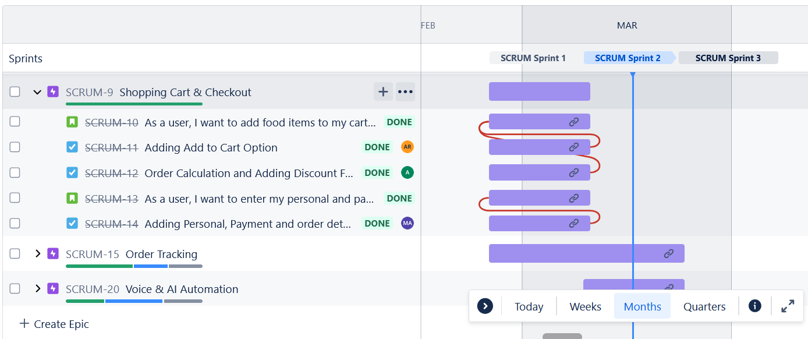
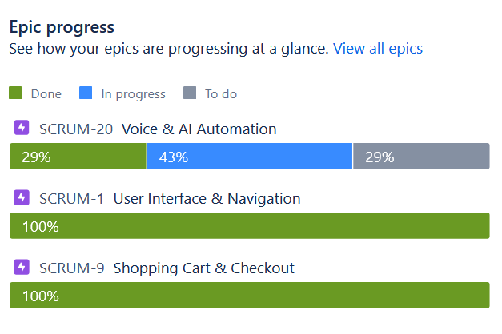
Project Planning (Jira)
Organized sprints, user stories, and epics.
Visualized task assignments and sprint progress.
Ensured efficient backlog management and prioritization.

Slide 7
Challenges & Risk Management
Challenges Faced:
Integration delays with speech-to-text API.
Managing responsiveness for different device screens.
Ensuring accuracy in speech-to-text.
Risk Mitigation:
Flexible sprint adjustments.
Frequent team discussions to address evolving needs.
Ongoing testing to mitigate API failures.

Slide 8
Project Progress
Achieved:
UI prototype completed.
Speech-to-text functionality integrated.
Pending:
Order confirmation automation.
AI-based order suggestions.

Slide 9
Key Learnings
Scrum methodology enhanced team coordination.
Gained hands-on experience in voice interaction systems.
Adaptive sprint planning helped tackle unexpected challenges.

Slide 10
Conclusion & Q/A
A voice-assisted, AI-driven system revolutionizing restaurant ordering, making the process faster and more efficient.

